Slide 1
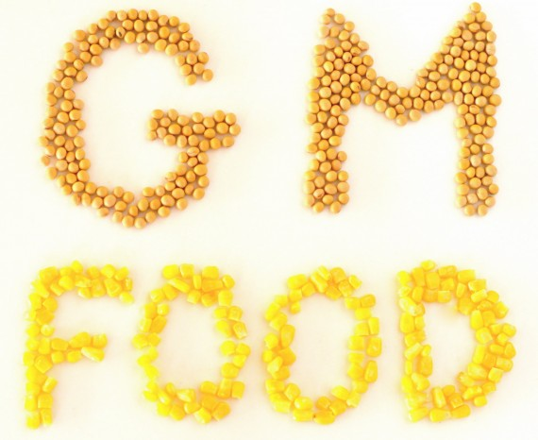
genetically-modified food VSIGDZ.COM

Slide 2
These plants have been modified in the laboratory to enhance desired traits such as improved nutritional content. For example, plant geneticists can isolate a gene responsible for drought tolerance and insert that gene into a different plant. Not only can genes be transferred from one plant to another, but genes from non-plant organisms also can be used. The best known example of this is the use of genes in corn and other crops.

Slide 3
Advantages of GM foods?
The world population has topped 6 billion people and is predicted to double in the next 50 years. Ensuring an adequate food supply for this booming population is going to be a major challenge in the years to come. GM foods promise to meet this need in a number of ways:
-Disease resistance There are many viruses, fungi and bacteria that cause plant diseases. Plant biologists are working to create plants with genetically-engineered resistance to these diseases
-Pharmaceuticals Medicines and vaccines often are costly to produce and sometimes require special storage conditions not readily available in third world countries. Researchers are working to develop edible vaccines in tomatoes and potatoes. These vaccines will be much easier to ship, store and administer than traditional injectable vaccines.

Slide 4
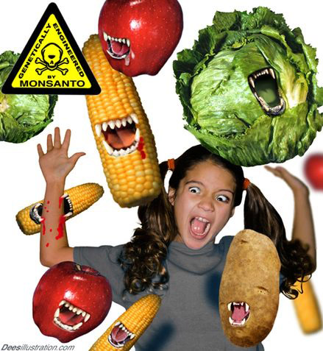
Argument against
Reduced effectiveness of pesticides Just as some populations of mosquitoes developed resistance to the now-banned pesticide DDT, many people are concerned that insects will become resistant to crops that have been genetically-modified to produce their own pesticides.

Slide 5
Human health risks
Allergenicity Many children in the US and Europe have developed life-threatening allergies to peanuts and other foods. There is a possibility that introducing a gene into a plant may create a new allergen or cause an allergic reaction in susceptible individuals. A proposal to incorporate a gene from Brazil nuts into soybeans was abandoned because of the fear of causing unexpected allergic reactions31. Extensive testing of GM foods may be required to avoid the possibility of harm to consumers with food allergies. Labeling of GM foods and food products will acquire new importance, which I shall discuss later.

Slide 6
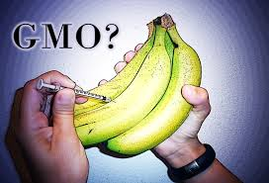
Unknown effects on human health
There is a growing concern that introducing foreign genes into food plants may have an unexpected and negative impact on human health. A recent article published in Lancet examined the effects of GM potatoes on the digestive tract in rats32, 33. This study claimed that there were appreciable differences in the intestines of rats fed GM potatoes and rats fed unmodified potatoes. Yet critics say that this paper, like the monarch butterfly data, is flawed and does not hold up to scientific scrutiny34. Moreover, the gene introduced into the potatoes was a snowdrop flower lectin, a substance known to be toxic to mammals. The scientists who created this variety of potato chose to use the lectin gene simply to test the methodology, and these potatoes were never intended for human or animal consumption.

